Slide 1
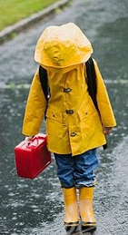
VS
The “HOOD” The “umbrella”

